Slide 1
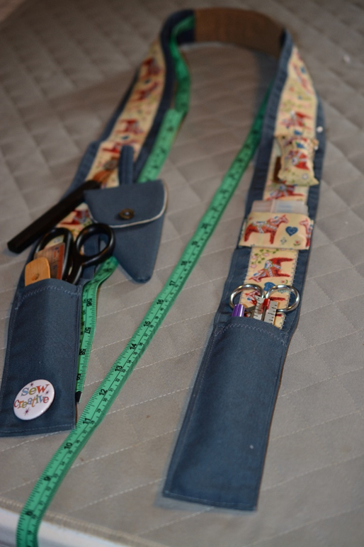
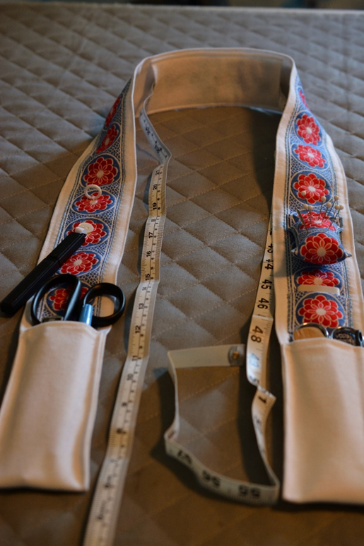
Tool Caddy for Sewists
Stay organized on the move with a
Personal Chatelaine

Slide 2
Materials List
Fabric – about 60” to 70” long, 6 ½” wide
2 yards of cloth ribbon, about 2” wide
Matching thread
A few small buttons (optional)
Small scrap of suede, ultrasuede, or light leather (for under the pincushion)
Stuffing for pincushion
Scrap of skid-resistant felt, suede, or velvet for center back (to avoid slippage)

Slide 3
Decide tools to include
Suggestions:
Lightweight scissors
Clipper/snips
Markers
Pins/Clips
Ruler/gauge
Point thingy
Measuring Tape
Bodkin
Seam ripper
Best for
smaller items that you use regularly,
things that run and hide while you sew, and
tools that you carry among sewing stations.

Slide 4
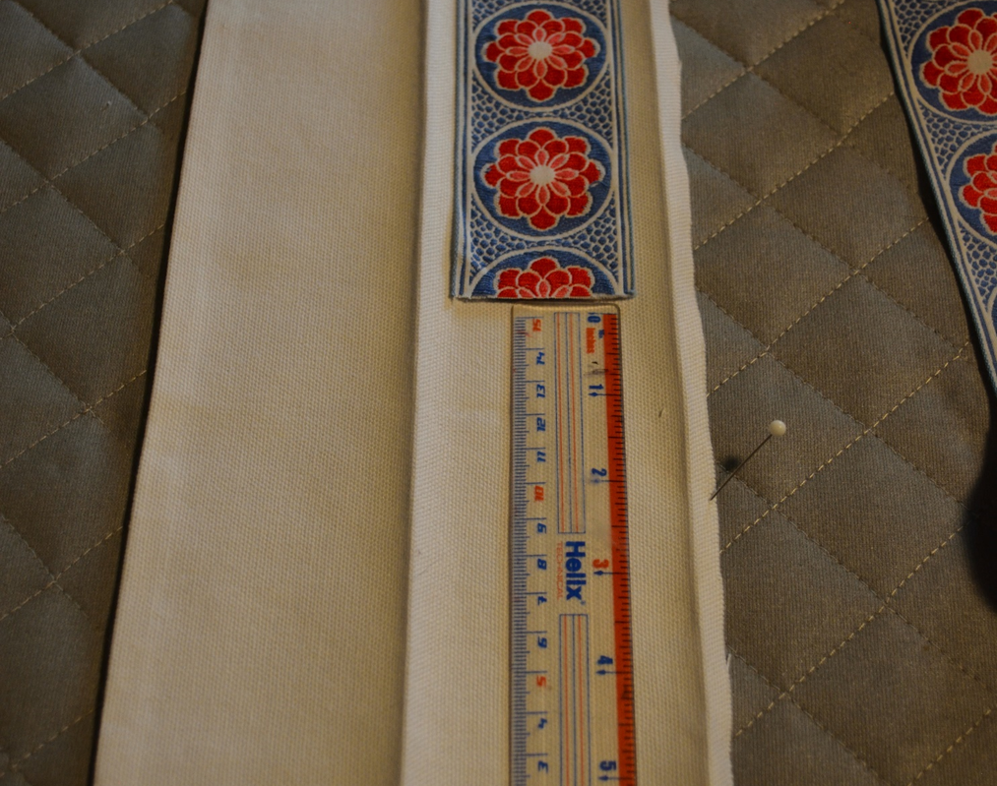
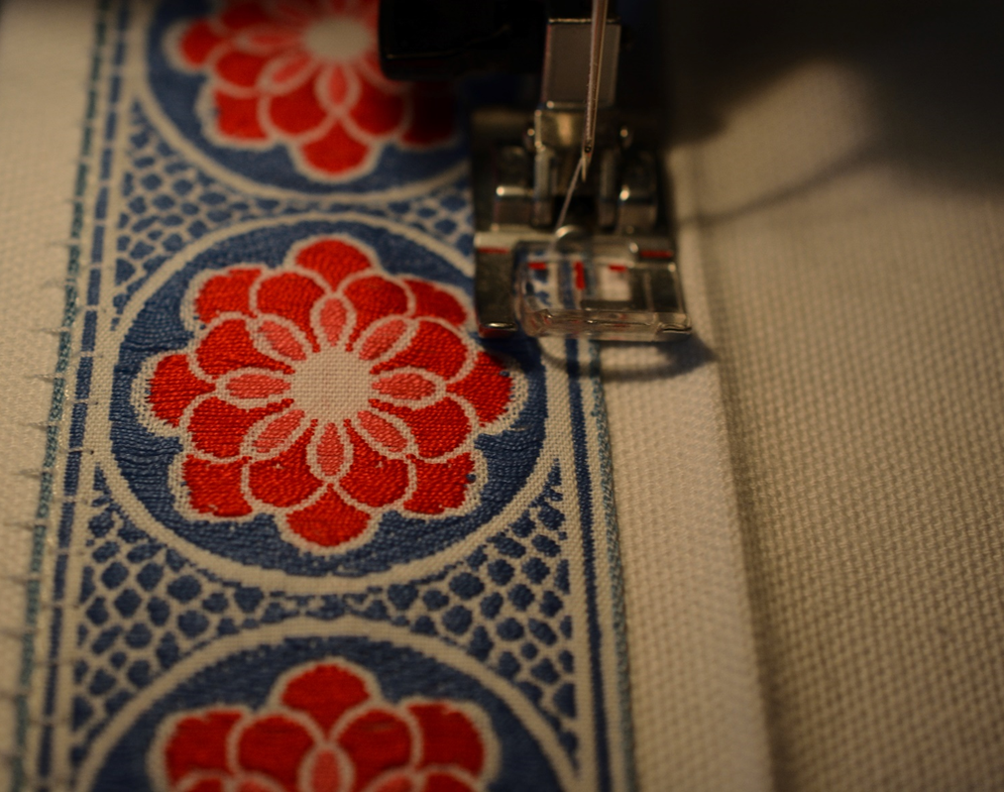
Prepare the strap
To Prepare the base strap:
Fold in half lengthwise and press
Turn under ¼” on each long edge and press
Center the ribbon on one long side of the base, starting and ending about 6” from the ends
Sew the ribbon to one half of the base strap along the long edges (use a decorative stitch if desired)
* I used a clear presser foot here to align the stitch
The ribbon and tools will be attached to one half, then covered by the other half.
The 6” at each end will be turned up to form pockets.

Slide 5
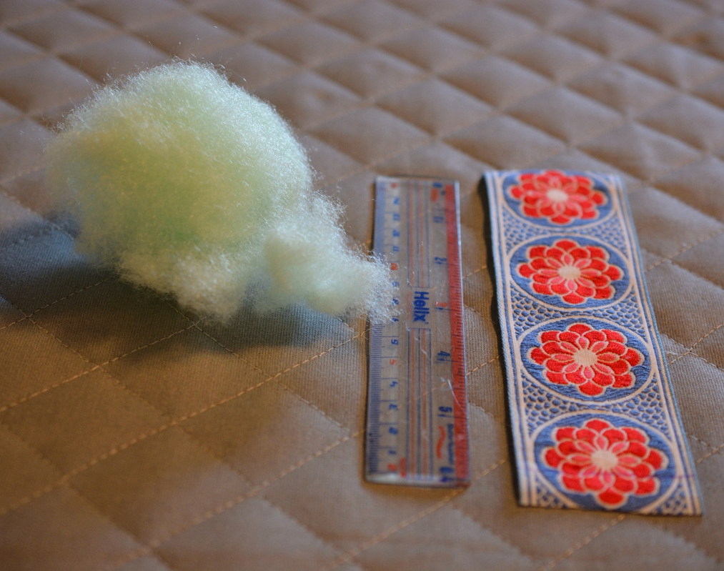
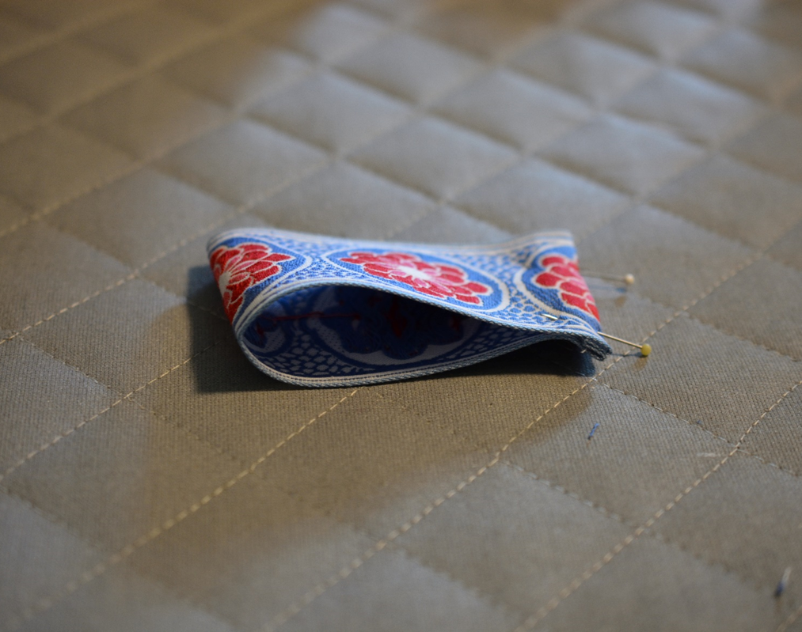
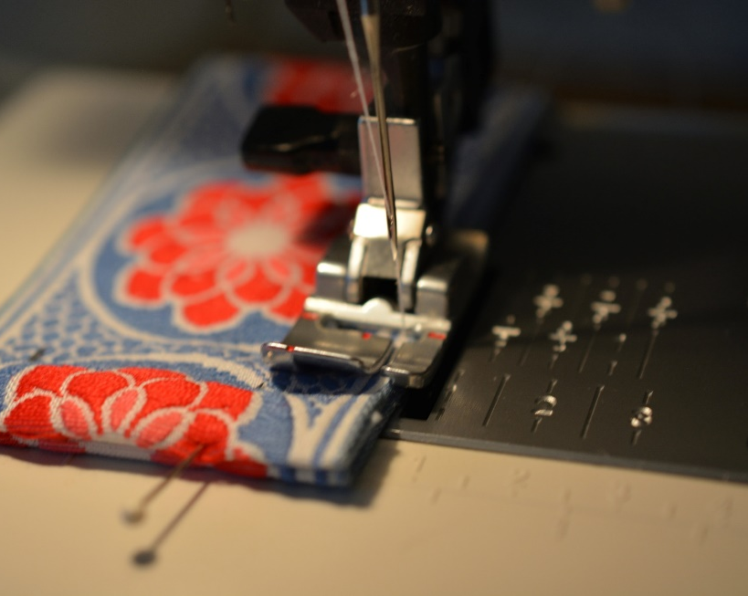
Pincushion
To make a pincushion:
Cut a length of ribbon about 6” long
Press under ¼” on the ends, fold in half and pin the ends
Stitch the sides
Stuff tightly
*I used an uneven edge stitch foot for the sides

Slide 6
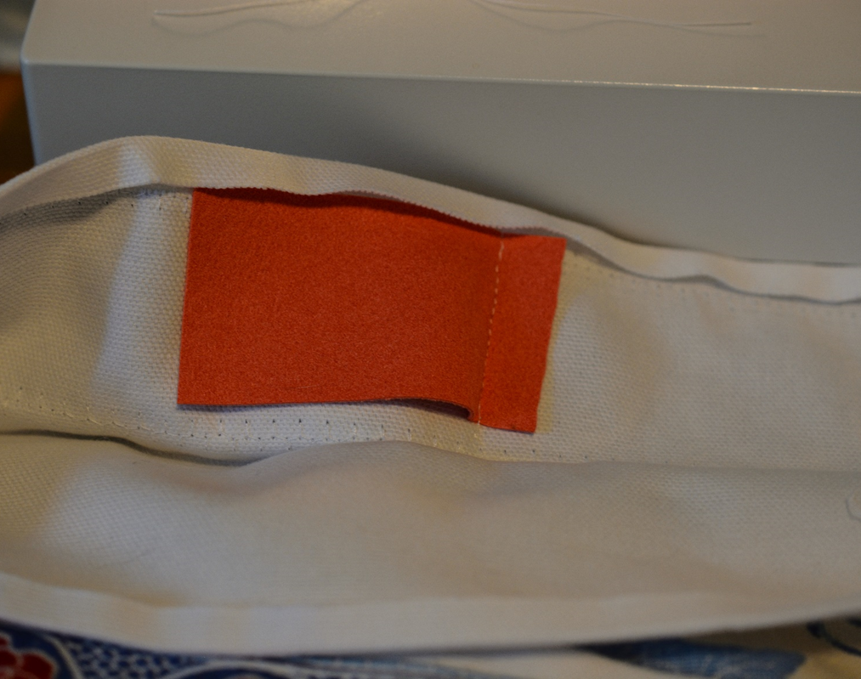
Attach Pincushion
Pack in the stuffing leaving about a ½” flap on the pressed end.
Attach to base by stitching close to cushion edge and again close to stuffing, about 18” up from the raw edge of the strap.
To protect yourself from getting stuck, stitch a small scrap of leather or ultrasuede to the area just under the cushion.
Lacking color matched leather, you can hide the scrap on the inside.
*Use a zipper foot to attach the cushion

Slide 7
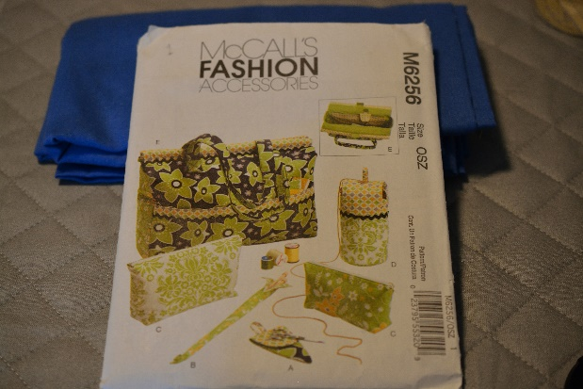
Attach permanent tools
Thread Snips
Little pocket for tailors chalk, presser feet (for quick swap), buttons, etc.
My original included a small scissors holder attached by a strap. (from McCall’s 6256, patterns for organizing knitting stuff).
…I made some changes in the new model

Slide 8
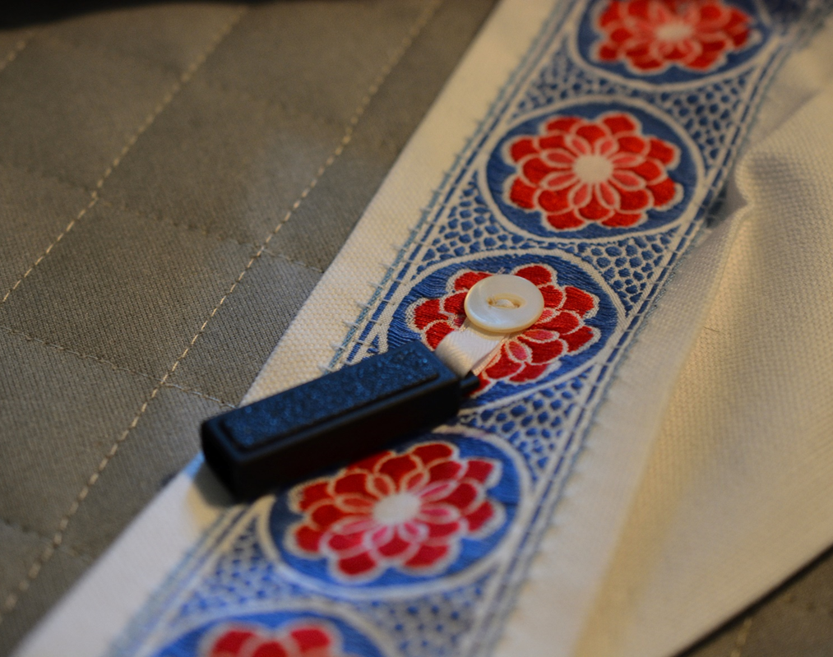
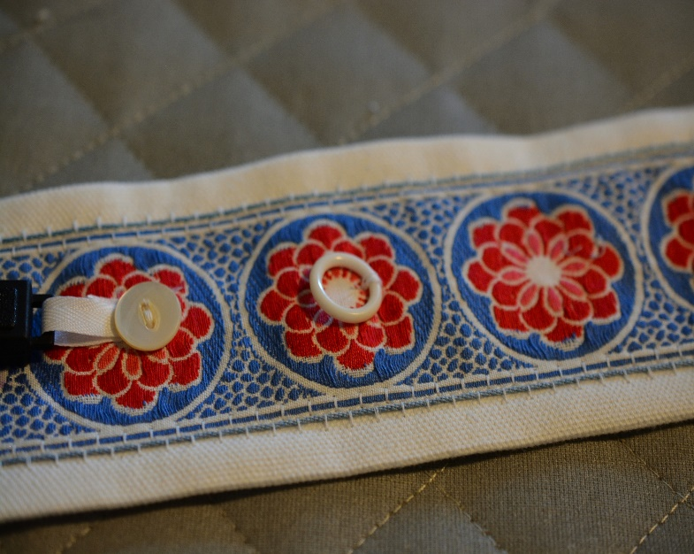
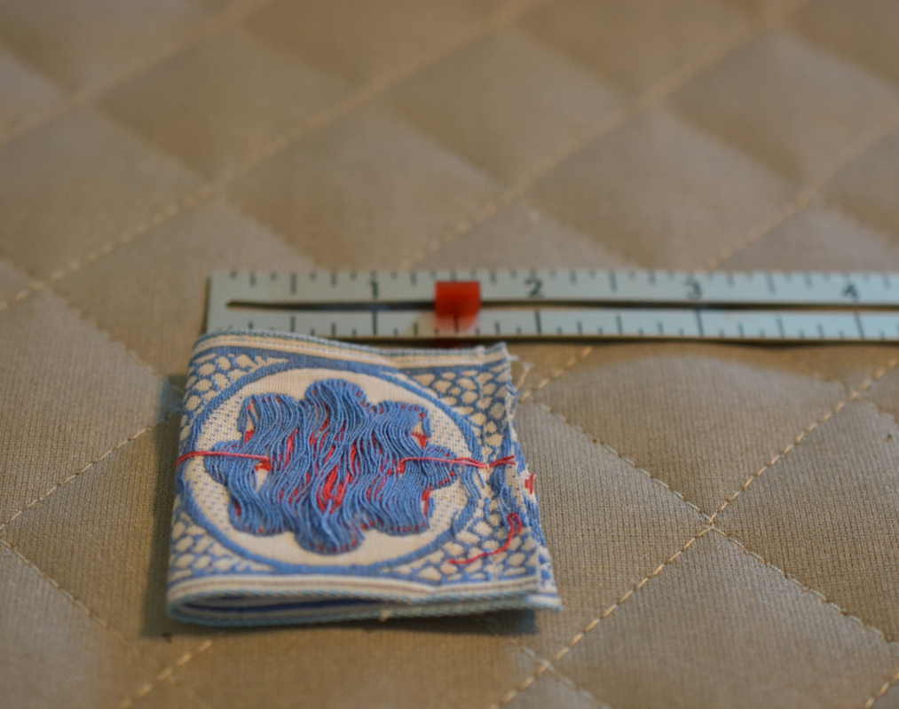
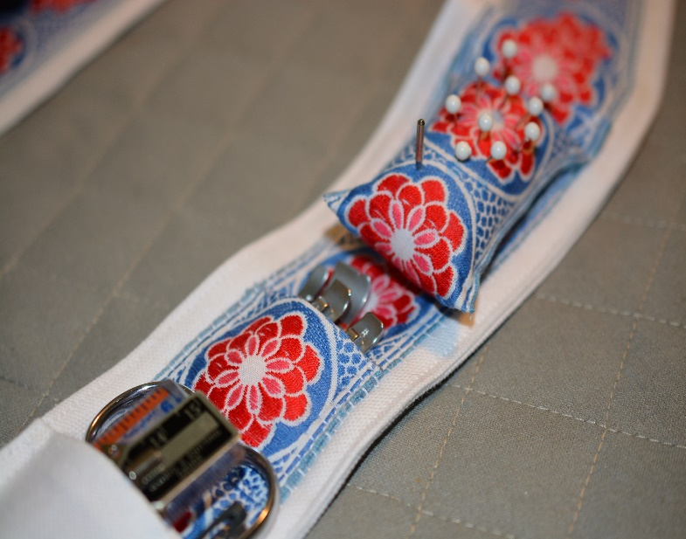
More suggestions Tools and Pockets
Use ¼” twill tape to attach the snips, then top with a decorative button
Attach a small circle to create a cording guide
For the small pocket, use a 4½” length of ribbon.
Fold right sides together and stitch cut edges
Turn right side out, press, and stitch to ribbon strap at the sides about 13” up from the raw edge.
Test out the placement of each item on the chatelaine. You will be folding up the tails about 6” to form pockets.

Slide 9
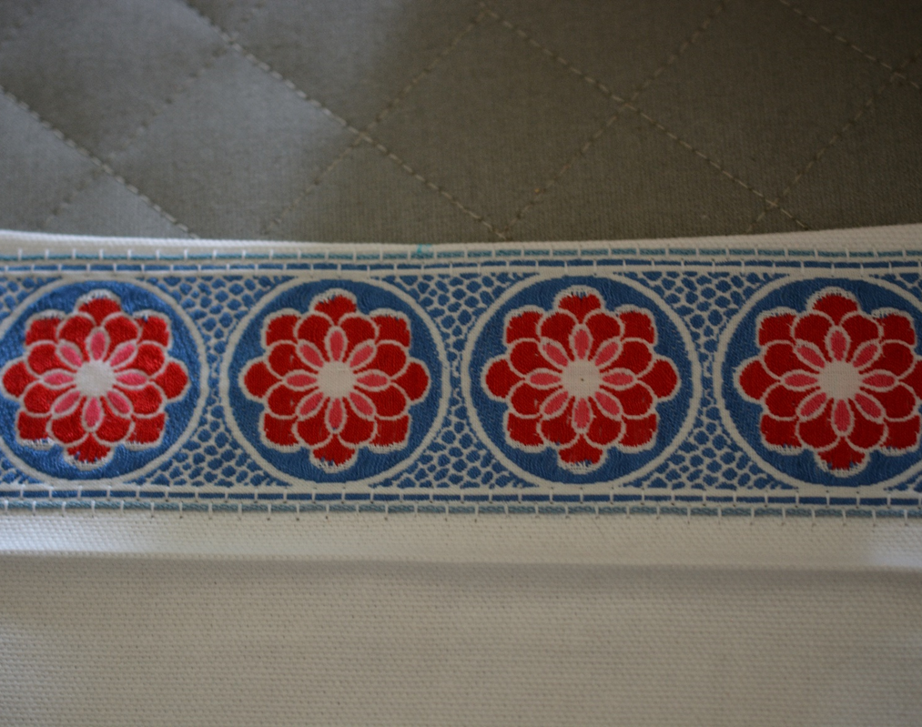
Close up and create end pockets
Fold under bottom edges and stitch the hem – don’t stitch the fold closed
Fold the strap closed lengthwise and edgestitch along the entire length of both long edges
To narrow the neck area, tuck in the folded edges to meet the ribbon
Fold up the strap ends up about 5½” and stitch the sides to create end pockets
If desired, stitch a narrow pocket channel for a pointy thing or pencil
*An uneven edgestitch foot or regular edgestitch foot helps

Slide 10
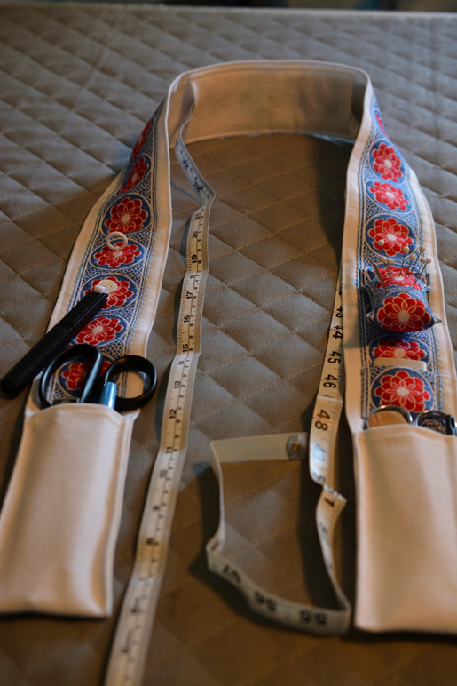
Finish up!
Add a 6” strip of felt or other slip-resistant material to center back and stitch along long edges.
Slide a tape measure under the felt.
Fill the pockets with your tools.
LOCKED AND LOADED

Slide 11
My Assistants
Sundance – he sits on things
Etta Cat – she sits on white things

